Slide 1
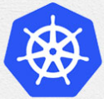
4 Kubernetes Architecture
Peter H. Chen

Slide 2
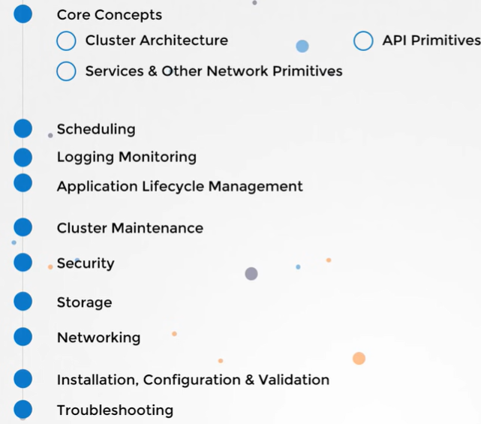
4 Kubernetes Architecture
https://www.youtube.com/watch?v=8C_SCDbUJTg&list=PL2We04F3Y_43dAehLMT5GxJhtk3mJtkl5&index=4
Kubernetes (or K8s) Architecture
We discuss Kubernetes Architecture.

Slide 3
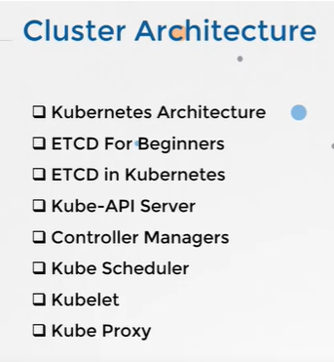
4 Kubernetes Architecture
https://www.youtube.com/watch?v=8C_SCDbUJTg&list=PL2We04F3Y_43dAehLMT5GxJhtk3mJtkl5&index=4
Kubernetes (or K8s) Architecture
We start to look at the cluster architecture at high level.
Then, we drill down into each of these components.
We see what their roles and responsibilities are.
..and how they are configured.

Slide 4
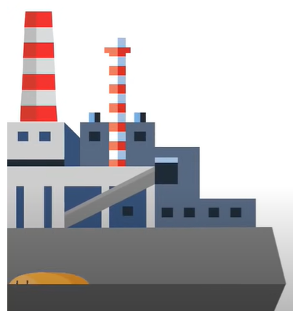

4 Kubernetes Architecture
https://www.youtube.com/watch?v=8C_SCDbUJTg&list=PL2We04F3Y_43dAehLMT5GxJhtk3mJtkl5&index=4
Kubernetes (or K8s) Architecture
…and finally, we go through a practice test where we look at an exiting cluster
…and are asked to identify where is details with respect to these components in the cluster.
We are going to use an analogy of ships to understand the architecture of Kubernetes.

Slide 5
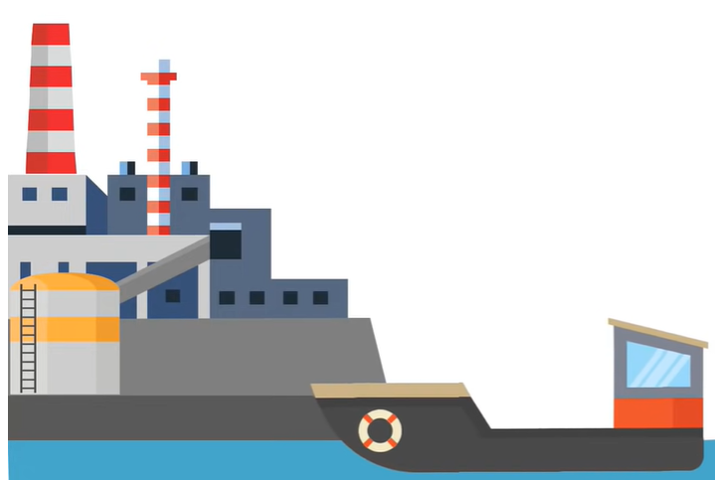
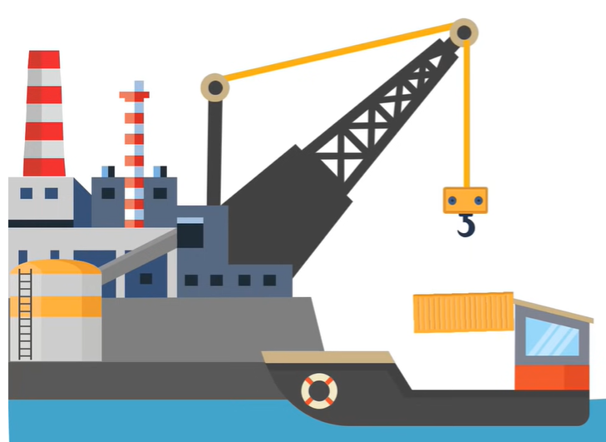
4 Kubernetes Architecture
https://www.youtube.com/watch?v=8C_SCDbUJTg&list=PL2We04F3Y_43dAehLMT5GxJhtk3mJtkl5&index=4
Kubernetes (or K8s) Architecture
The purpose of Kubernetes is to host your applications in the form of containers in an automated fashion.
..so that you can easily to deploy as many instances of your application as required.
..and easily enable communication between services within your application.

Slide 6
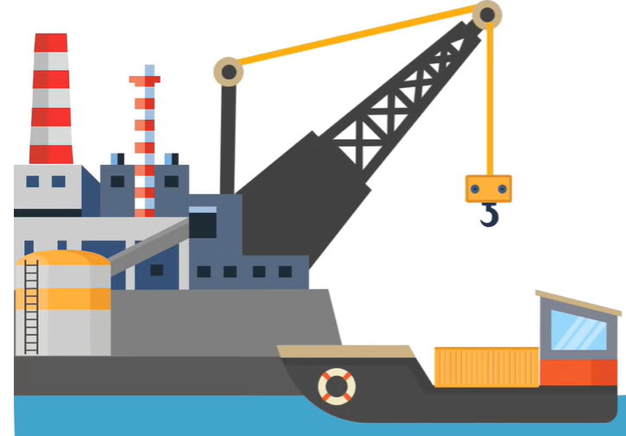
4 Kubernetes Architecture
https://www.youtube.com/watch?v=8C_SCDbUJTg&list=PL2We04F3Y_43dAehLMT5GxJhtk3mJtkl5&index=4
Kubernetes (or K8s) Architecture
..so, there are many things involved that work together to make this possible.

Slide 7

4 Kubernetes Architecture
https://www.youtube.com/watch?v=8C_SCDbUJTg&list=PL2We04F3Y_43dAehLMT5GxJhtk3mJtkl5&index=4
Kubernetes (or K8s) Architecture
..so, let’s take a loot and Kubernetes architecture.
In this example, we have two kinds of ships.
The cargo ship that does the actual work of carry containers across the sea.
..and control ships that are responsible for monitoring and managing the cargo ships.

Slide 8
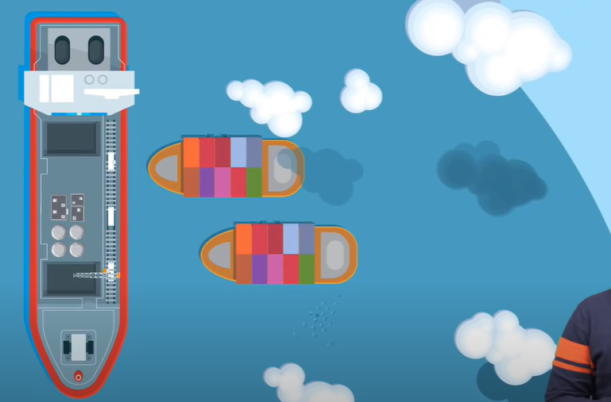
4 Kubernetes Architecture
https://www.youtube.com/watch?v=8C_SCDbUJTg&list=PL2We04F3Y_43dAehLMT5GxJhtk3mJtkl5&index=4
Kubernetes (or K8s) Architecture
The Kubernetes cluster consists of a set of nodes which may be physical of virtual machine on cloud that hosts the application in the form of containers.
These relate to the cargo ships in this analogy.

Slide 9
4.1 Worker Node

Slide 10
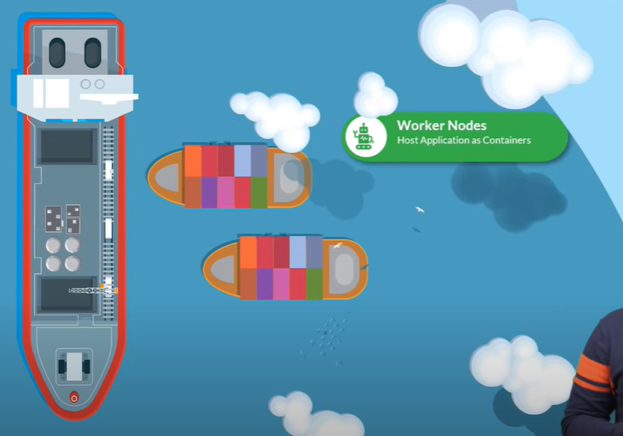
4.1 Worker Node
https://www.youtube.com/watch?v=8C_SCDbUJTg&list=PL2We04F3Y_43dAehLMT5GxJhtk3mJtkl5&index=4
Worker Node (1:50/9:30)
The Worker Nodes (Ships) in the cluster are ships that can load Applications (Containers).
…but somebody needs to load the Containers (Application) on the Ships (Worker Nodes).
…and not just load,
…plan how to load,
…identify the right ship,
…store information about the ship,
…monitor and track the location of containers on the ship
…manage the whole loading process, etc.
Worker Nodes (Ships)
Host Application (as Containers)

Slide 11
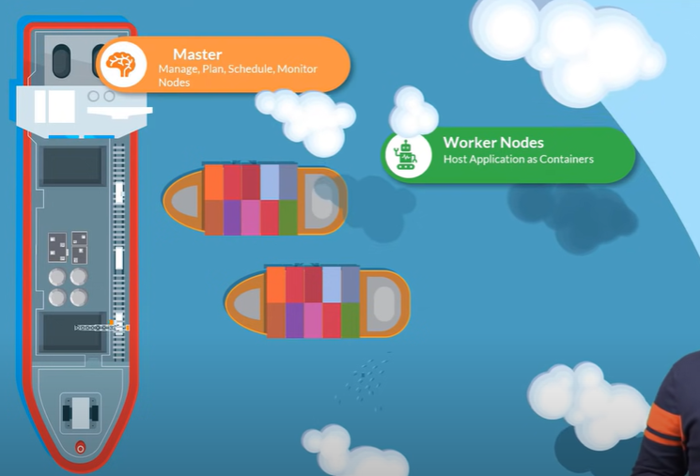
4.1 Worker Node
https://www.youtube.com/watch?v=8C_SCDbUJTg&list=PL2We04F3Y_43dAehLMT5GxJhtk3mJtkl5&index=4
Worker Node (2:30/9:30)
These are done by the control ships that hosts different offices, different departments, monitoring equipment, communication equipment, cranes, etc. for moving containers between ships, etc.
The control ship is related to the master node in the Kubernetes cluster.
The Master Node is responsible for managing the Kubernetes Cluster storing information regarding the different nodes, planning which container goes which ship, monitoring containers on which ship, etc.
Master Nodes (Control Ship)
Manage, Plan, Schedule, Monitor Nodes
Worker Nodes (Ships)
Host Application (as Containers)

Slide 12
4.1 Worker Node
https://www.youtube.com/watch?v=8C_SCDbUJTg&list=PL2We04F3Y_43dAehLMT5GxJhtk3mJtkl5&index=4
Worker Node (2:41/9:30)
The master node does all of these using a set of components together known as the control plan components.
We will look at each of these components now.
Master Nodes (Control Ship)
Manage, Plan, Schedule, Monitor Nodes
Worker Nodes (Ships)
Host Application (as Containers)

Slide 13
4.2 Master Node

Slide 14
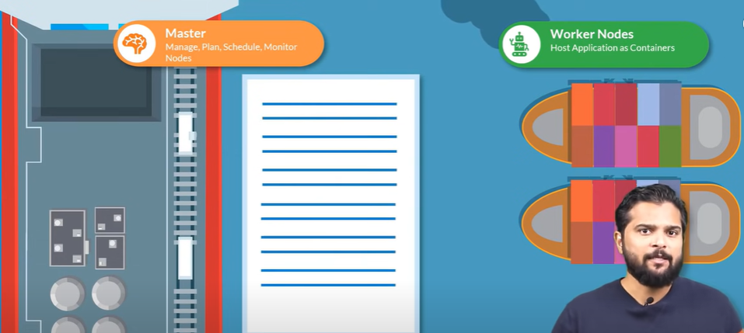
4.2 Master Node
https://www.youtube.com/watch?v=8C_SCDbUJTg&list=PL2We04F3Y_43dAehLMT5GxJhtk3mJtkl5&index=4
Master Node (2:45/9:30)
There are many containers being loaded and unloaded from the ships daily.
…and we need to maintain information about the different ships what container is on which ship.
…what time it was loaded, etc.
Master Nodes (Control Ship)
Manage, Plan, Schedule, Monitor Nodes
Worker Nodes (Ships)
Host Application (as Containers)

Slide 15
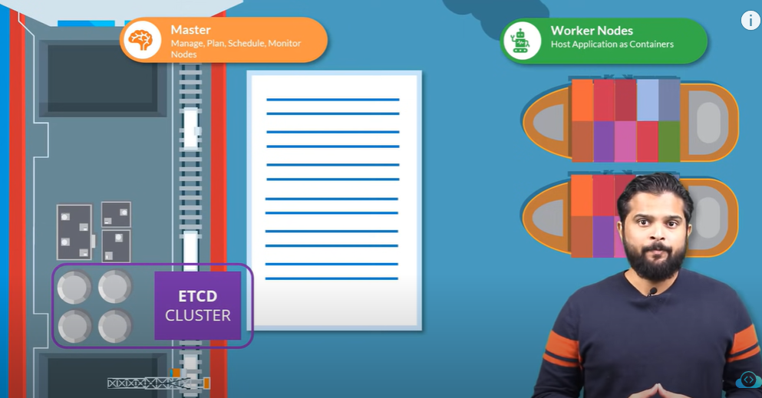
4.2 Master Node
https://www.youtube.com/watch?v=8C_SCDbUJTg&list=PL2We04F3Y_43dAehLMT5GxJhtk3mJtkl5&index=4
Master Node (2:55/9:30)
All of these are stored in a highly available key-value store known as etcd (etc. distributed) cluster.
The etcd is a database that stores information in a key-value format.
We will discuss more in etcd cluster: What data is stored in it and how it stores the data.
Master Nodes (Control Ship)
Manage, Plan, Schedule, Monitor Nodes
Worker Nodes (Ships)
Host Application (as Containers)

Slide 16
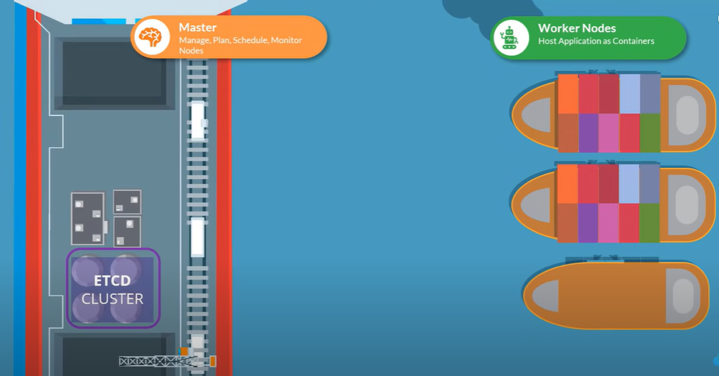
4.2 Master Node
https://www.youtube.com/watch?v=8C_SCDbUJTg&list=PL2We04F3Y_43dAehLMT5GxJhtk3mJtkl5&index=4
Master Node (3:14/9:30)
When ships arrive, we load containers on the ships using crane.
Master Nodes (Control Ship)
Manage, Plan, Schedule, Monitor Nodes
Worker Nodes (Ships)
Host Application (as Containers)

Slide 17
4.3 Kube-Scheduler

Slide 18
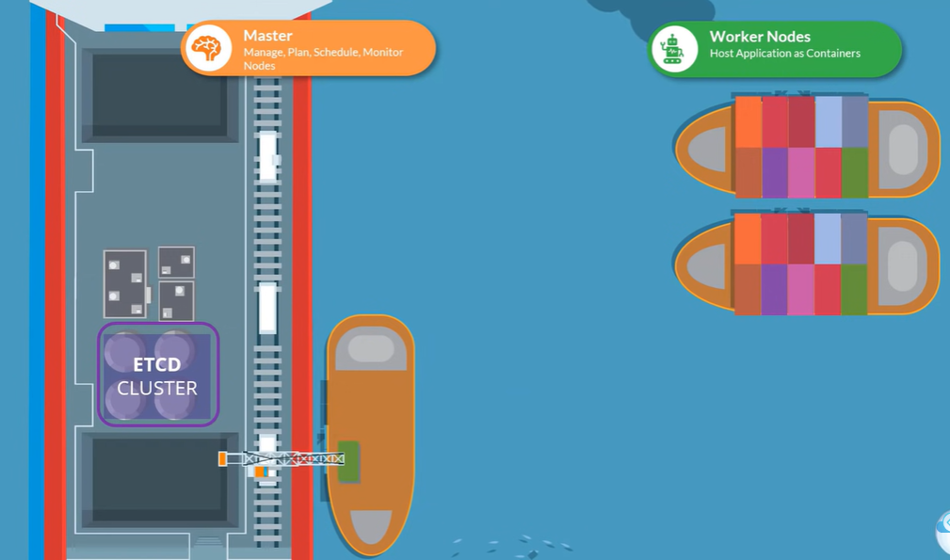
4.3 Kube-Scheduler
https://www.youtube.com/watch?v=8C_SCDbUJTg&list=PL2We04F3Y_43dAehLMT5GxJhtk3mJtkl5&index=4
Kube-Scheduler (3:22/9:30)
The cranes (kube-scheduler) identify the containers that need to be placed on ships.
The cranes identify the right ship based on ship size, ship capacity, the number of containers already on ships, and other conditions, such as, the destination of the ship, the type of containers that ship is allowed to carry, etc.
Master Nodes (Control Ship)
Manage, Plan, Schedule, Monitor Nodes
Worker Nodes (Ships)
Host Application (as Containers)
When ships arrive, we load containers on the ships using cranes.
The cranes identify the containers that need to be placed on ships.
The cranes identify the right ship.

Slide 19
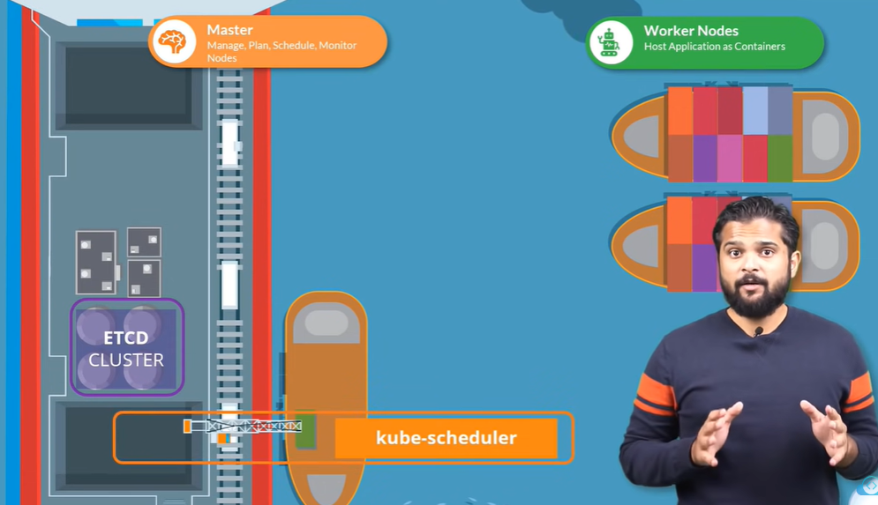
4.3 Kube-Scheduler
https://www.youtube.com/watch?v=8C_SCDbUJTg&list=PL2We04F3Y_43dAehLMT5GxJhtk3mJtkl5&index=4
Kube-Scheduler (3:35/9:30)
So, cranes are kube-schedulers in a Kubernetes cluster.
A kube-scheduler identifies the right node to place a container on based on container resource requirements, the work nodes capacity, any other policies, or constraints, such as, toleration or rules around them. We will discuss more later.
Master Nodes (Control Ship)
Manage, Plan, Schedule, Monitor Nodes
Worker Nodes (Ships)
Host Application (as Containers)
Kube-Schedule

Slide 20
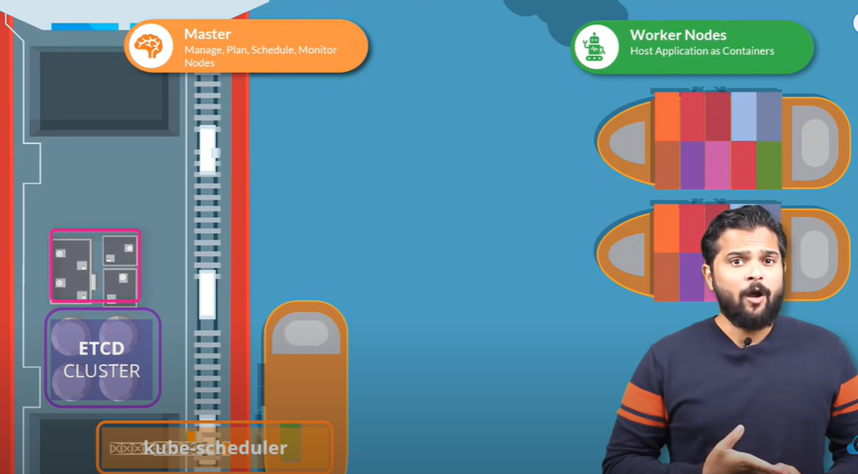
4.3 Kube-Scheduler
https://www.youtube.com/watch?v=8C_SCDbUJTg&list=PL2We04F3Y_43dAehLMT5GxJhtk3mJtkl5&index=4
Kube-Scheduler (4:01/9:30)
There are different offices in the dock that are assigned to special tasks or departments, for example, the operations team take care of ship handling, traffic control, etc.
They deal with issues related to damages; the routes of different ships take, etc.
Master Nodes (Control Ship)
Manage, Plan, Schedule, Monitor Nodes
Worker Nodes (Ships)
Host Application (as Containers)
Kube-Schedule

Slide 21
4.3 Kube-Scheduler
https://www.youtube.com/watch?v=8C_SCDbUJTg&list=PL2We04F3Y_43dAehLMT5GxJhtk3mJtkl5&index=4
Kube-Scheduler (4:16/9:30)
The cargo team take care of containers.
When containers are damage or destroyed, they make sure the new containers are made available.
We have these services office that takes care of IT and communications between different ships.
Master Nodes (Control Ship)
Manage, Plan, Schedule, Monitor Nodes
Worker Nodes (Ships)
Host Application (as Containers)
Kube-Schedule

Slide 22
4.4 Controller

Slide 23
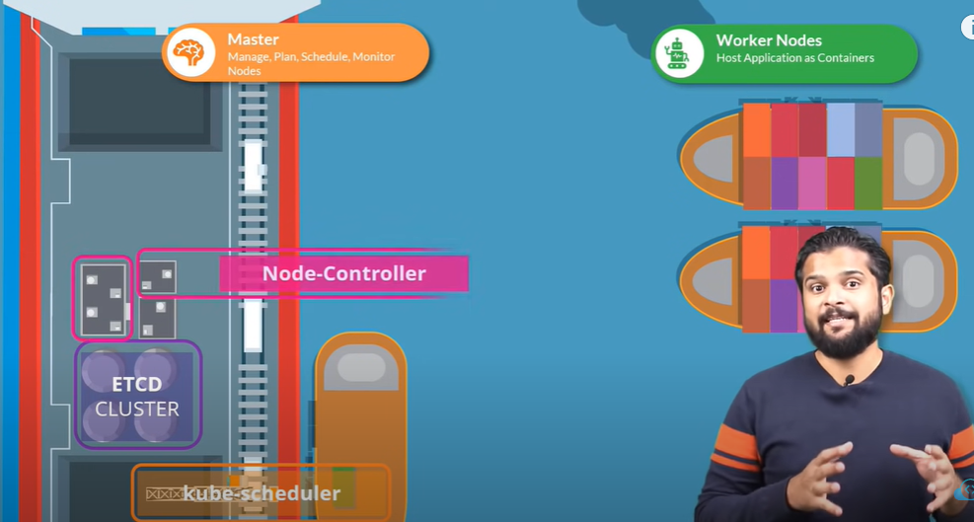
4.4 Controller
https://www.youtube.com/watch?v=8C_SCDbUJTg&list=PL2We04F3Y_43dAehLMT5GxJhtk3mJtkl5&index=4
Controller (4:28/9:30)
Similarly, in Kubernetes, we have controllers available that take care of different areas.
Master Nodes
Manage, Plan, Schedule, Monitor Nodes
Worker Nodes
Host Application as Containers
Node-controller
Kube-Schedule

Slide 24
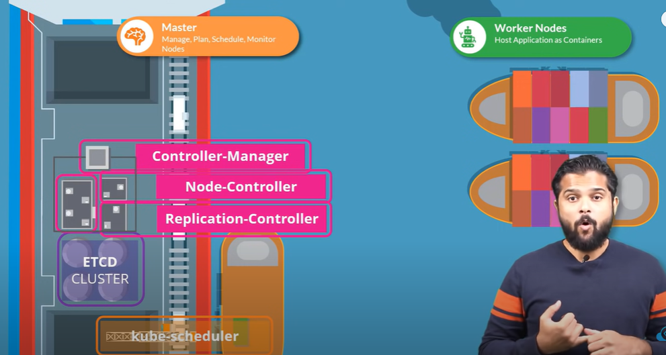
4.4 Controller
https://www.youtube.com/watch?v=8C_SCDbUJTg&list=PL2We04F3Y_43dAehLMT5GxJhtk3mJtkl5&index=4
Controller (4:36/9:30)
The node-controller takes care of nodes.
The node-controller is responsible for on-boarding new nodes to the cluster, handling situations where nodes become unavailable, or get destroyed.
…and the replication-controller ensures that the desired number of containers are always running in our repetition nodes.
Master Nodes
Manage, Plan, Schedule, Monitor Nodes
Worker Nodes
Host Application as Containers
Controller-Manager
Node-controller
Replication-controller
Kube-Schedule

Slide 25
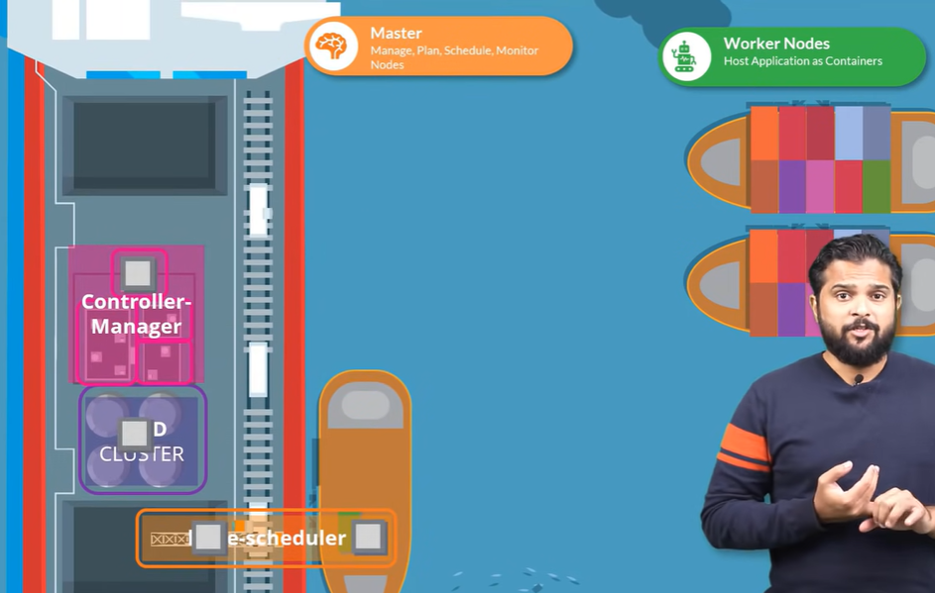
4.4 Controller
https://www.youtube.com/watch?v=8C_SCDbUJTg&list=PL2We04F3Y_43dAehLMT5GxJhtk3mJtkl5&index=4
Controller (4:56/9:30)
We have seen different components like the different offices, the different ships, the data store, the cranes.
..but how do these communicate with each others.
Master Nodes
Manage, Plan, Schedule, Monitor Nodes
Worker Nodes
Host Application as Containers
Controller-Manager
etcd cluster
Kube-Schedule

Slide 26
4.5 Kube-apiserver

Slide 27
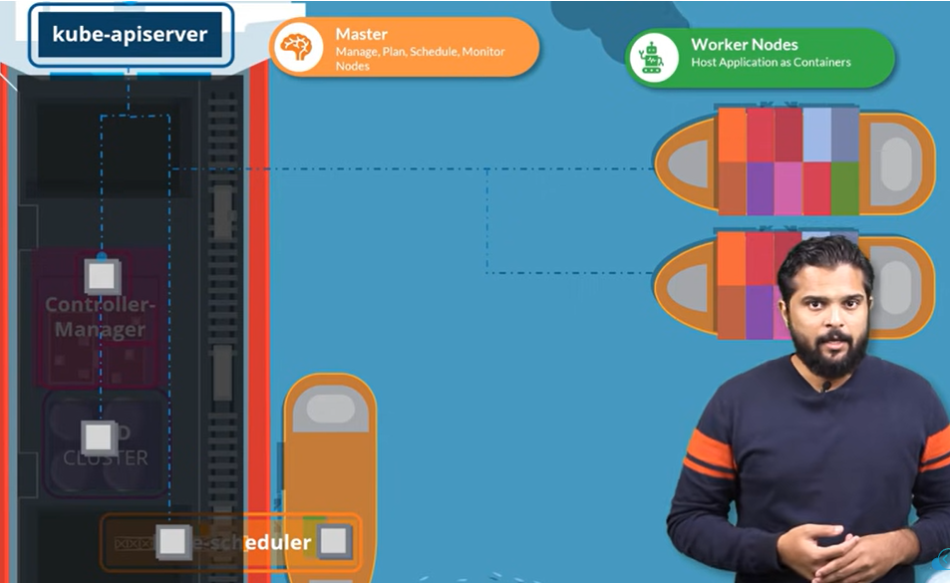
4.5 Kube-apiserver
https://www.youtube.com/watch?v=8C_SCDbUJTg&list=PL2We04F3Y_43dAehLMT5GxJhtk3mJtkl5&index=4
Kube-apiserver (5:08/9:30)
How does one office reach the other office, and who manages them all at a high level.
The kube-apiserver which is used by external users to perform management operation on the cluster as well as the various controllers to monitor the state of the cluster and make necessary changes as required.
…and the worker nodes to communicate with the server.
Kube-apiserver

Slide 28
4.5 Kube-apiserver
https://www.youtube.com/watch?v=8C_SCDbUJTg&list=PL2We04F3Y_43dAehLMT5GxJhtk3mJtkl5&index=4
Kube-apiserver (5:37/9:30)
Now, we are working with containers here. There are a lot of constrainers.
We need all running applications to be container compatible.
Our applications are in the form of containers.
The different components that form the entire management system on the master node could be hosted in the form of containers.
The DNS (Domain Name Service) service and networking solution can all be deployed in the form of containers.
We need the software that can run containers.
That is the container runtime engine, a popular docker.
Kube-apiserver

Slide 29
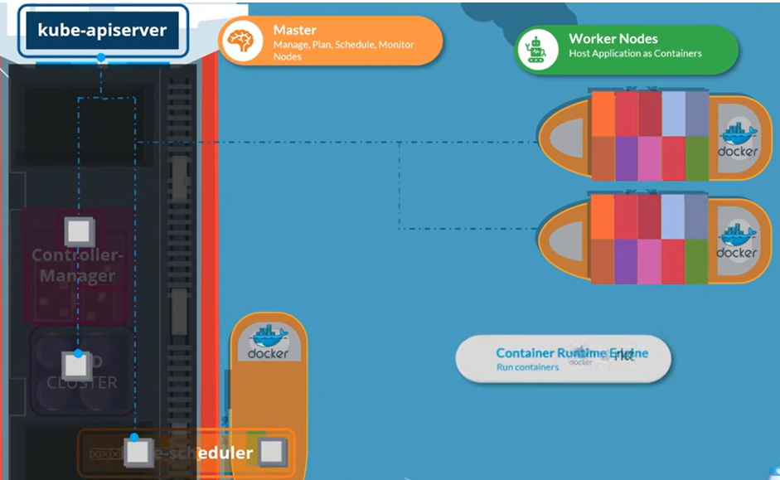
4.5 Kube-apiserver
https://www.youtube.com/watch?v=8C_SCDbUJTg&list=PL2We04F3Y_43dAehLMT5GxJhtk3mJtkl5&index=4
Kube-apiserver (6:09/9:30)
So, we need docker installed on all the nodes in the cluster, including the master node if we want to host the control plan components as containers.
Now, we always have Kubernetes supports other runtime engines as well, such as, rocket.

Slide 30
4.6 Kubelet

Slide 31
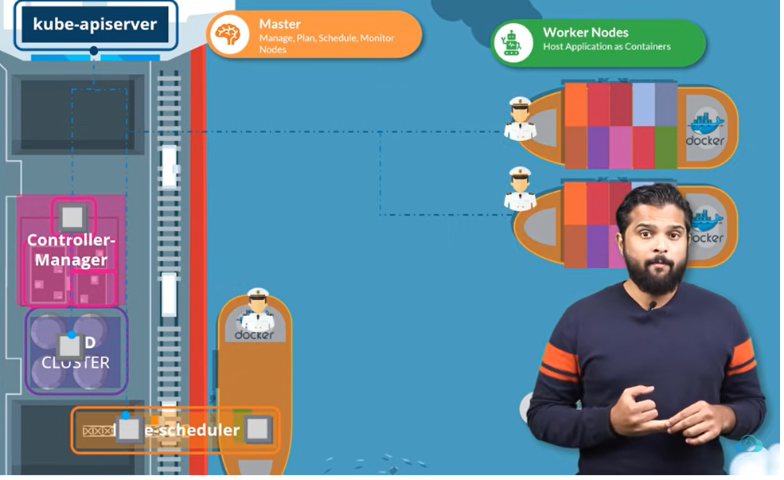
4.6 Kubelet
https://www.youtube.com/watch?v=8C_SCDbUJTg&list=PL2We04F3Y_43dAehLMT5GxJhtk3mJtkl5&index=4
Kubelet (6:30/9:30)
Now, we turn our focus on the cargo ships.
Every ships have the captain.
Capitan is responsible for managing all activities on these ships.

Slide 32
4.6 Kubelet
https://www.youtube.com/watch?v=8C_SCDbUJTg&list=PL2We04F3Y_43dAehLMT5GxJhtk3mJtkl5&index=4
Kubelet (6:50/9:30)
The captain is responsible for release with the master ships starting with letting the master ship know
…that the ships are interested in joining the group, receiving the information about the containers to be loaded on the ship and loading the appropriate containers are required, sending the reports back to the master about the status of the ship, and the status of the containers on the ship, etc.

Slide 33
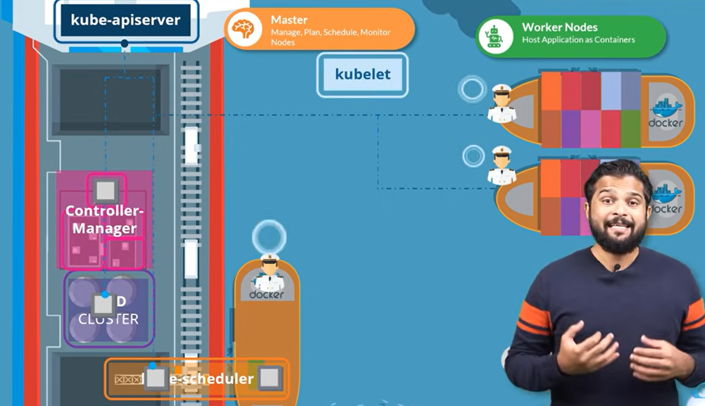
4.6 Kubelet
https://www.youtube.com/watch?v=8C_SCDbUJTg&list=PL2We04F3Y_43dAehLMT5GxJhtk3mJtkl5&index=4
Kubelet (7:03/9:30)
Now, the captain of the ship is the kubelet in the Kubernetes.
A Kubelet is an agent that runs on each node in a cluster.
The kubelet listens for instructions from the kube-apiserver.
The kubelet deploys or destroys containers on the nodes as required.

Slide 34
4.6 Kubelet
https://www.youtube.com/watch?v=8C_SCDbUJTg&list=PL2We04F3Y_43dAehLMT5GxJhtk3mJtkl5&index=4
Kubelet (7:19/9:30)
The Kube-apiserver periodically, fetches status reports from kubelet to monitor the status of nodes and containers on the nodes.
The kubelet is a captain on the ship that manages containers on the ship.
…but the applications running on the worker nodes need to be able to communicate with each other.

Slide 35
4.6 Kubelet
https://www.youtube.com/watch?v=8C_SCDbUJTg&list=PL2We04F3Y_43dAehLMT5GxJhtk3mJtkl5&index=4
Kubelet (7:37/9:30)
For example, we may have a web server running in one container on one of the nodes, and a database server running on another container on another node.
How would the web server reach a database server on the other node?

Slide 36
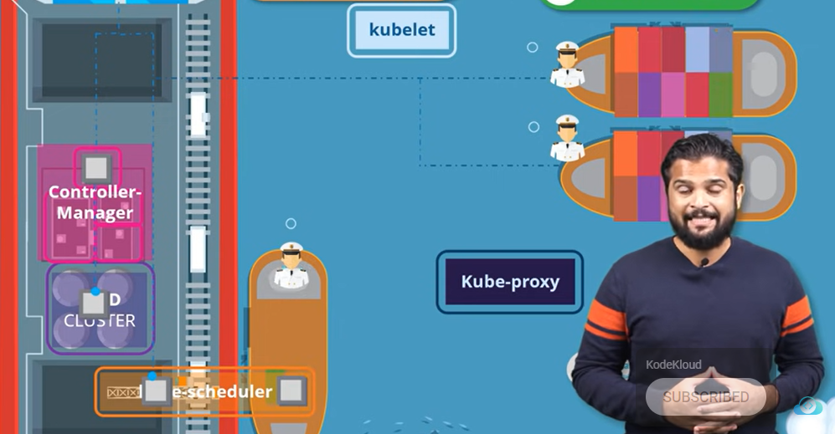
4.6 Kubelet
https://www.youtube.com/watch?v=8C_SCDbUJTg&list=PL2We04F3Y_43dAehLMT5GxJhtk3mJtkl5&index=4
Kubelet (7:54/9:30)
Communication between worker nodes are enabled by another component that runs on the worker node known as the kube-proxy service.
The kube-proxy service ensures that the necessary rules are in placed on the worker nodes to allow the containers running on them (worker nodes) to reach each others.

Slide 37
4.7 Summary

Slide 38
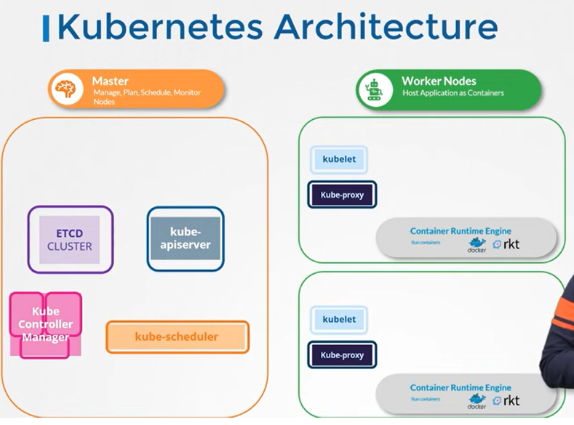
4.7 Summary
https://www.youtube.com/watch?v=8C_SCDbUJTg&list=PL2We04F3Y_43dAehLMT5GxJhtk3mJtkl5&index=4
Summary (8:10/9:30)
We have master and worker nodes.
On the master, we have etcd cluster which stores information about the cluster.
We have kube-scheduler that is responsible for scheduling applications or containers on nodes.

Slide 39
4.7 Summary
https://www.youtube.com/watch?v=8C_SCDbUJTg&list=PL2We04F3Y_43dAehLMT5GxJhtk3mJtkl5&index=4
Summary (8:25/9:30)
We have kube-controller that take care of different functions,
such as, node-controller or replication-controller, etc.
We have kube-apiserver that is responsible for orchestrating all operations withing the cluster.

Slide 40
4.7 Summary
https://www.youtube.com/watch?v=8C_SCDbUJTg&list=PL2We04F3Y_43dAehLMT5GxJhtk3mJtkl5&index=4
Summary (8:35/9:30)
On the worker node, we have kubelet.
..that listens for instruction from the kube-apiserver.
The kubelet manages the containers.
The kube-proxy that enabled in communication between the services within the cluster.

Slide 41
4.7 Summary
https://www.youtube.com/watch?v=8C_SCDbUJTg&list=PL2We04F3Y_43dAehLMT5GxJhtk3mJtkl5&index=4
Summary (8:50/9:30)
So, that is high level overview of the various components.
We will drill down into each of these in later.

Slide 42
End

